Slide 1
MOTO: Safety Served with Every Bite
Company Name : TECH TITANS
Project Title : Temperature Sensor Spoon
S.No | Name of the student | Year/Dept. | Email Id
1 | Christy E | 2nd yr/ECE | christy.ec23@krct.ac.in
2 | Dharshini P | 2nd yr/ECE | dharshini.ec23@krct.ac.in
3 | Janani M | 2nd yr/ECE | janani.ec23@krct.ac.in

Slide 2
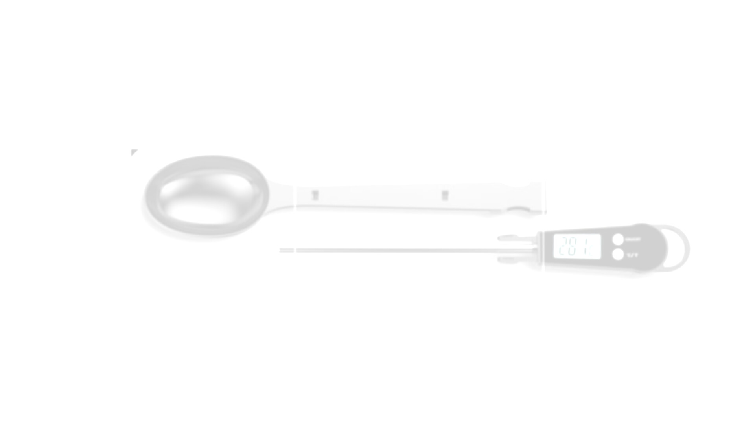
Temperature Sensor Spoon
CHRISTY E - ECA23019
DHARSHINI P - ECA23021
JANANI M - ECA23037

Slide 3
Problem Statement
The temperature sensor spoon is designed to provide real-time temperature readings of food or liquids, ensuring safe consumption and preventing burns. It is particularly beneficial for children, elderly individuals, and people with special needs, offering an extra layer of safety and convenience. This innovative device is portable, easy to use, and equipped with visual or auditory alerts to indicate when the temperature is too high or optimal for consumption. Ideal for personal use and caregiving environments, the sensor spoon enhances safety and practicality in everyday eating or feeding routines.

Slide 4

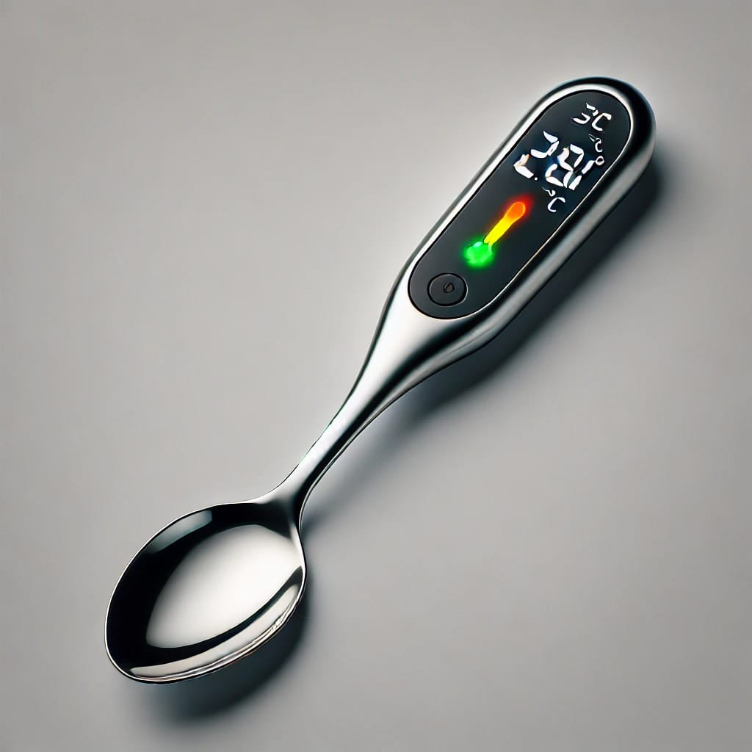
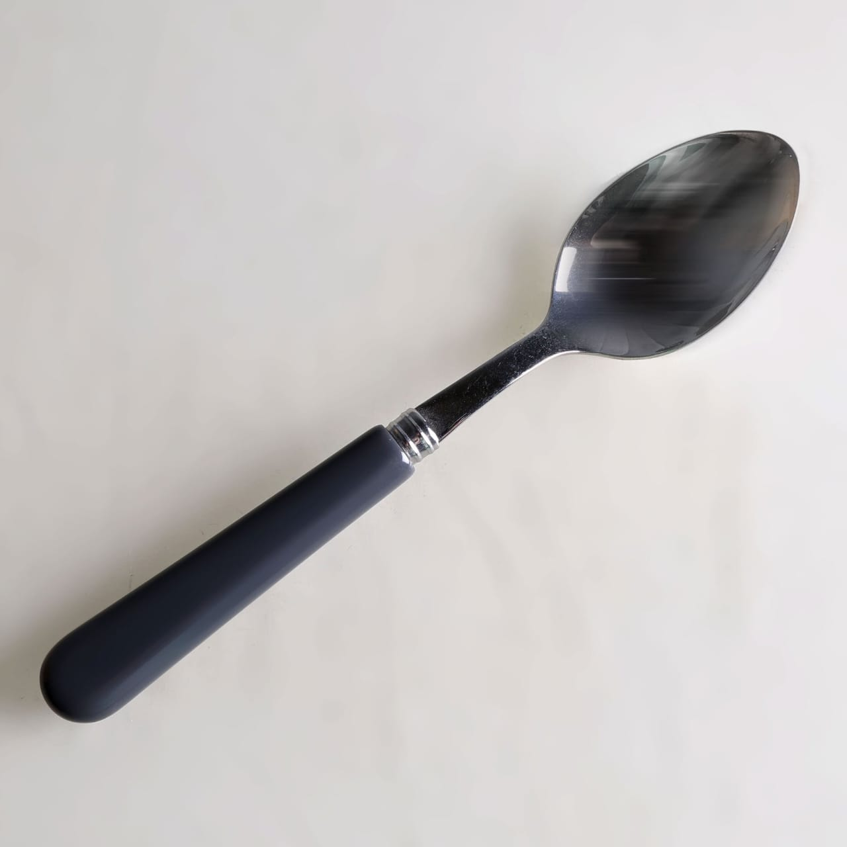
Existing Product Detail
The temperature spoon sensor ensures your food is always at the perfect and safe temperature before every bite

Slide 5
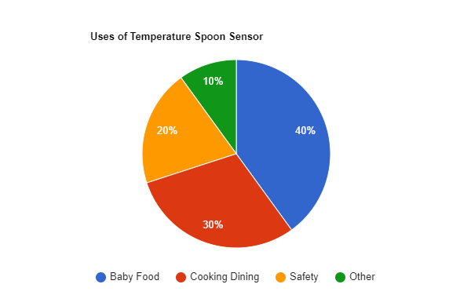
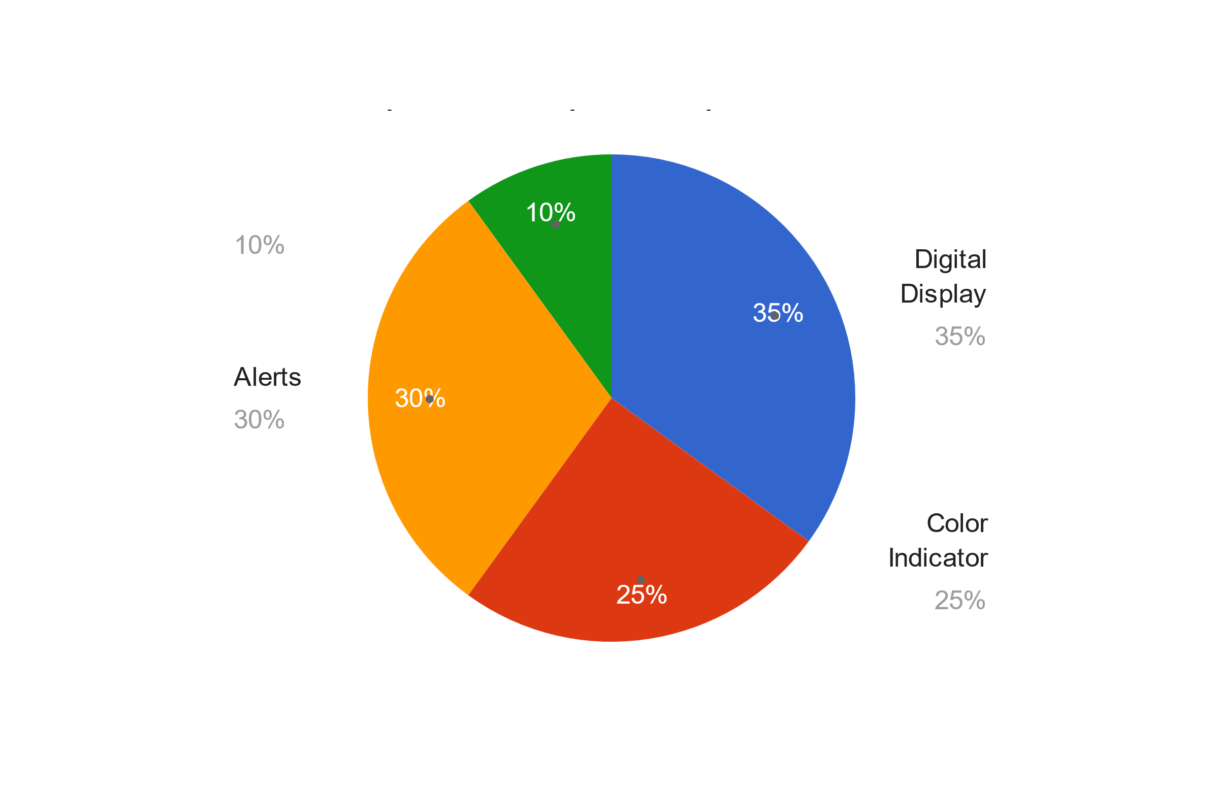
HIGHLIGHTED SURVEY REPORT

Slide 6
Solution (Or) Proposed Design

Slide 7
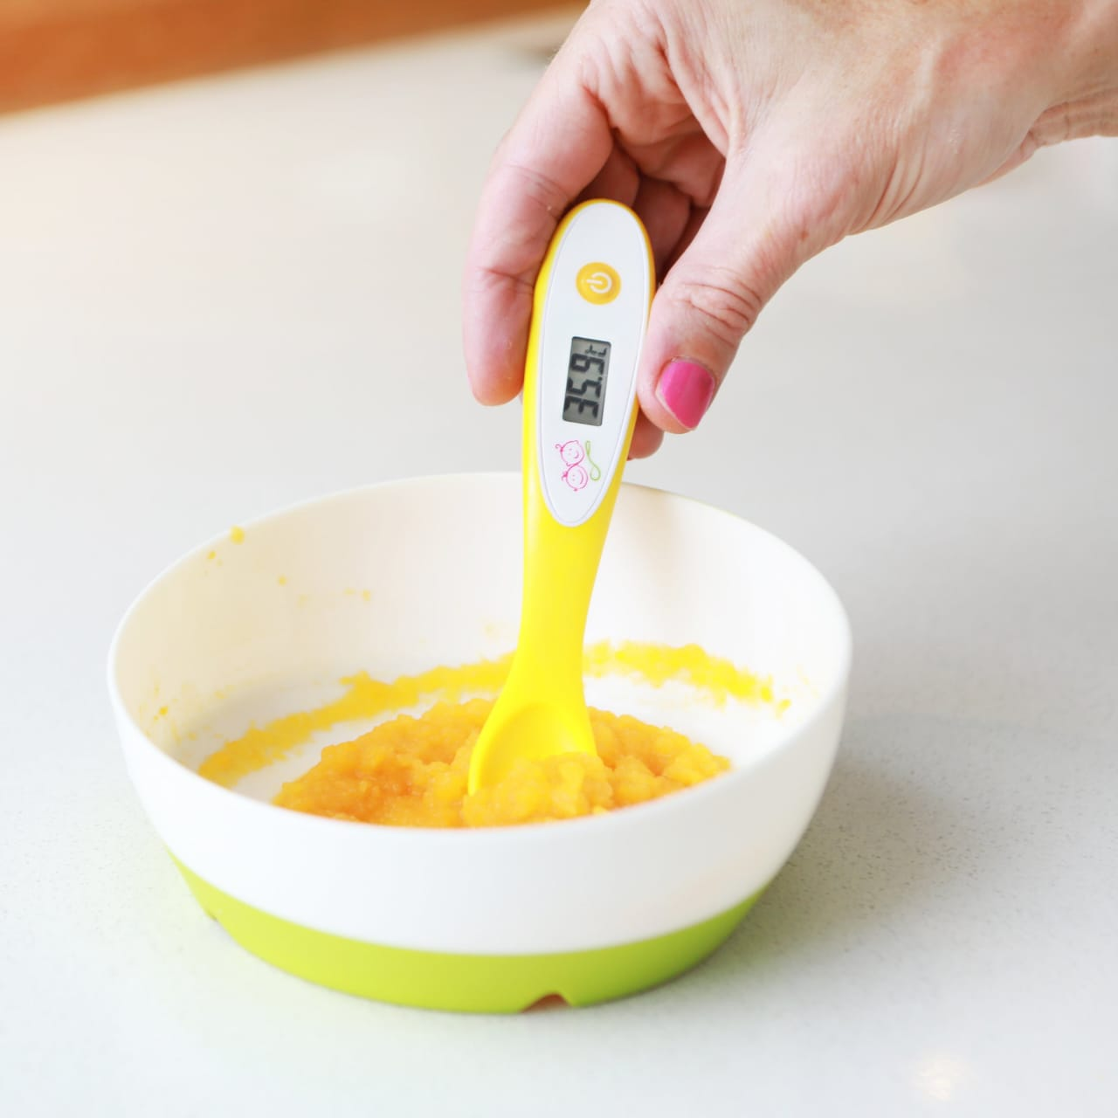
Working Of Invention

Slide 8
Target Marketing
Baby Products Stores
Elder Care Stores
Medical Equipment Shops
Online Health Stores
Camping and Outdoor Stores
Specialty Kitchen Shops
Appliance Retailers
General Retail Chains

Slide 9
Competitor Analysis
Alternate Solutions
Traditional spoons without temperature sensors.
Handheld infrared thermometers.
Liquid thermometers for food.
Testing temperature manually by touch or taste.
My Solution Product
Temperature Sensor Spoon with real-time alerts and safety features.

Slide 10
Value Proportion
Accurate real-time temperature readings.
Prevents burns with safe temperature alerts.
Hygienic and easy to clean.
Durable and long-lasting design.
Portable and user-friendly.
Suitable for all age groups.
Affordable and reliable solution.

Slide 11
Channels For Marketing
E-commerce Platforms (Amazon, eBay)
Company Website for Direct Sales
Social Media Ads (Instagram, Facebook)
Parenting and Caregiver Communities
Influencer Marketing in Food and Health Niches
Email Campaigns to Target Families and Caregivers
Kitchenware and Appliance Stores
Partnerships with Hospitals and Daycares
Online Video Demonstrations (YouTube, TikTok)

Slide 12
Revenue Model
Direct Sales through Website and Retail
Wholesale Distribution to Stores
Bundling with Kitchenware or Baby Products
Customization for Special Use Cases (e.g., engraving)
Subscription Model for Replacements or Add-ons
Online Advertising and Affiliate Marketing
Corporate Sales to Healthcare Providers
E-commerce Marketplaces (Amazon, eBay)

Slide 13
MARKETING STATERGY
Market Analysis
Target Audience: Parents, elderly, caregivers.
Competitor Analysis: Non-smart spoons, thermometers.
SWOT Analysis:
Strengths: Safety, accuracy.
Weaknesses: Battery.
Opportunities: Healthcare, baby care
Product Positioning
USP: Safe, accurate temperature readings.
Brand Messaging: "Safe Eating, Every Time."
Pricing Strategy: Affordable with premium options

Slide 14
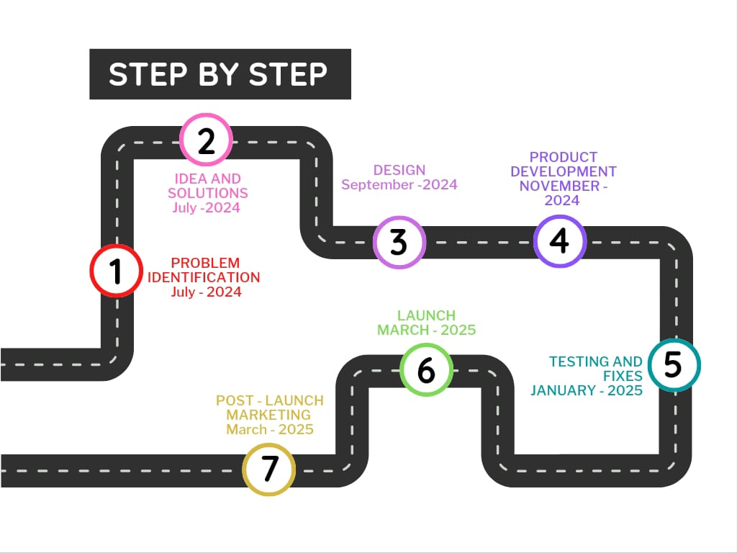
ROAD MAP

Slide 15
THANK YOU!

